Slide 1

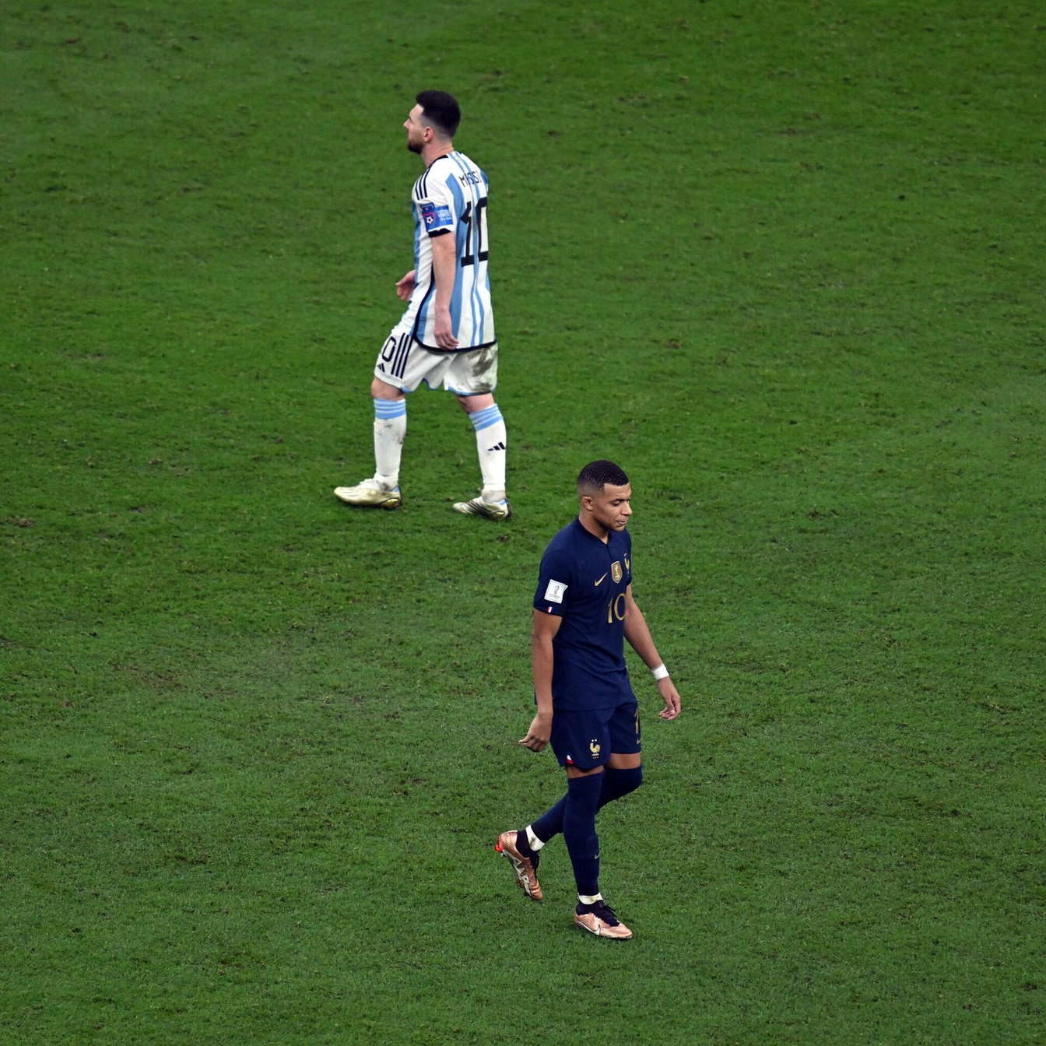
Modern Football Analysis Using Data Science
Beksultan Maatkulov(2056532)
Melis Zhorobaev(1992865)
Aleksandar Kirilov(2059920)

Slide 2

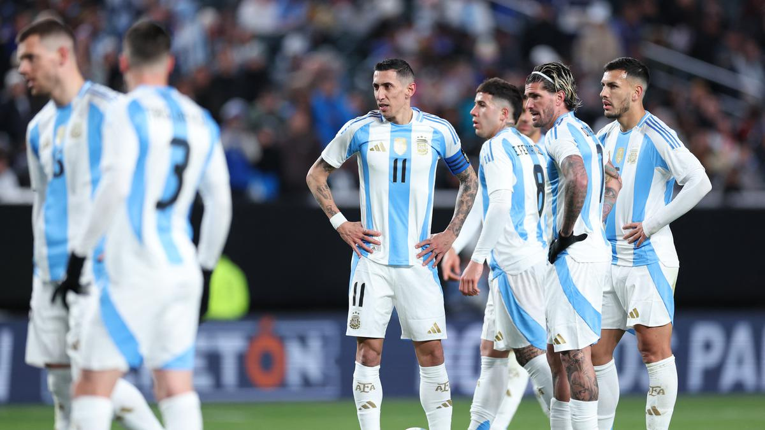
What can football statistics show us?

Slide 3
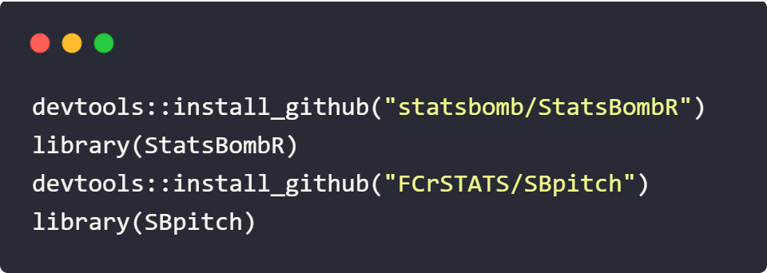

We are fetching information for our specific match from the StatsBomb dataset from their github repository using:
StatsBoomb is a data provider that collects accurate metrics of sport events, allowing for a very indepth technical analysis of how players and teams perform

Slide 4

01
02
03
04
Data fetching and filtering
Histogram and scatterplot
Heat map and Goal representation map
Pass Distribution Neural Network

Slide 5
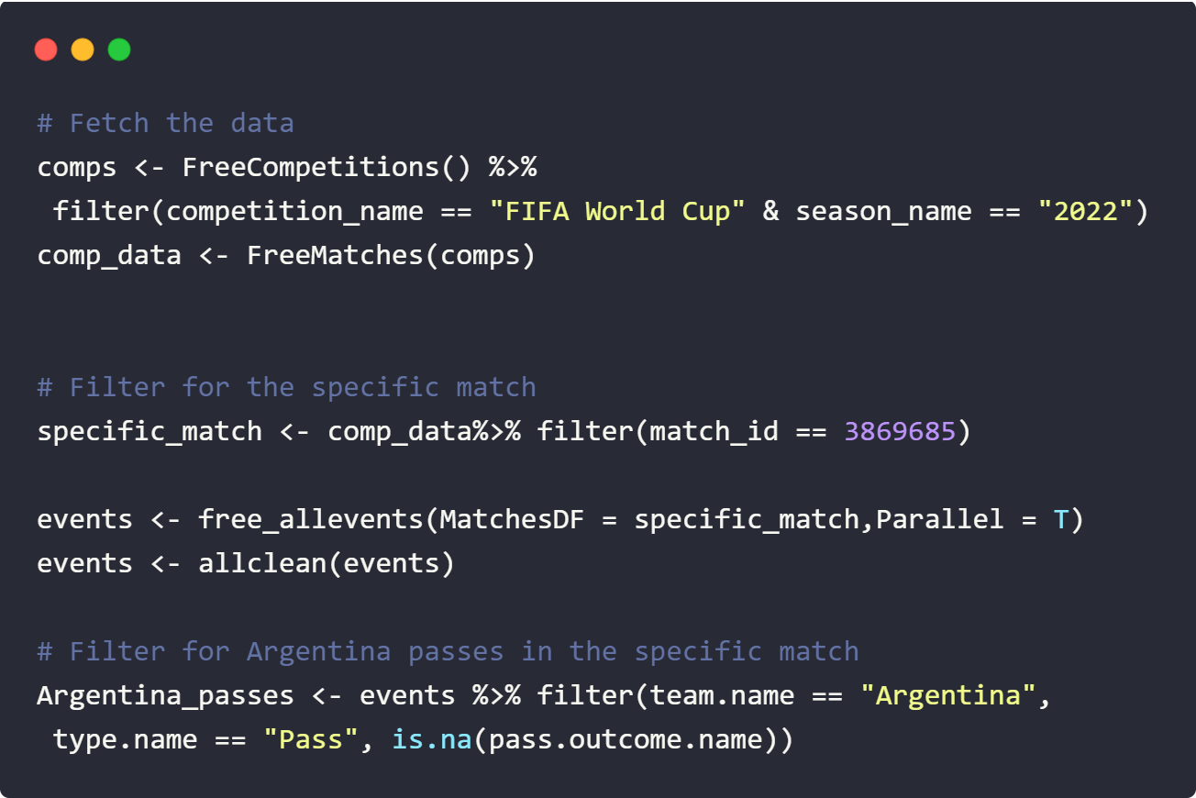
Data Fetching and filtering
-Retrieve data on available competitions
- Fetche match data for the specified competition and match
-Filter data only for Argentina players

Slide 6
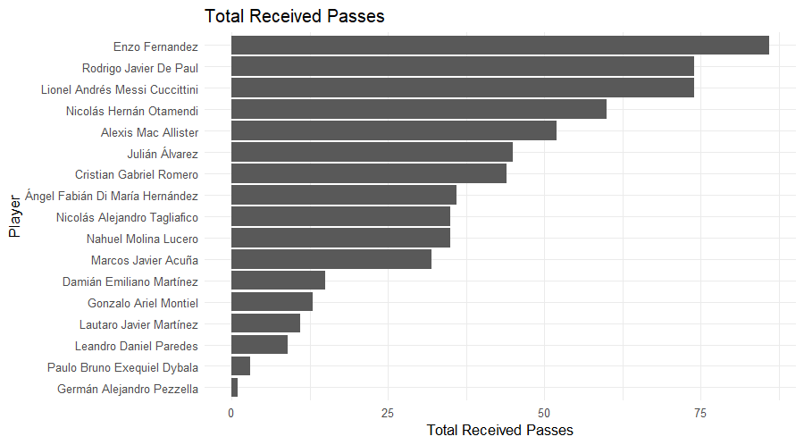
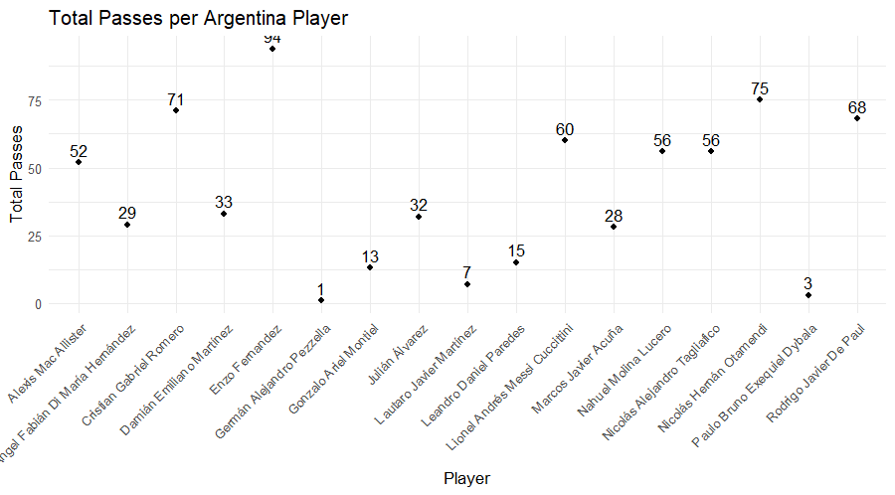
Passes received
Passes made

Slide 7
Can you see the correlation?

Slide 8

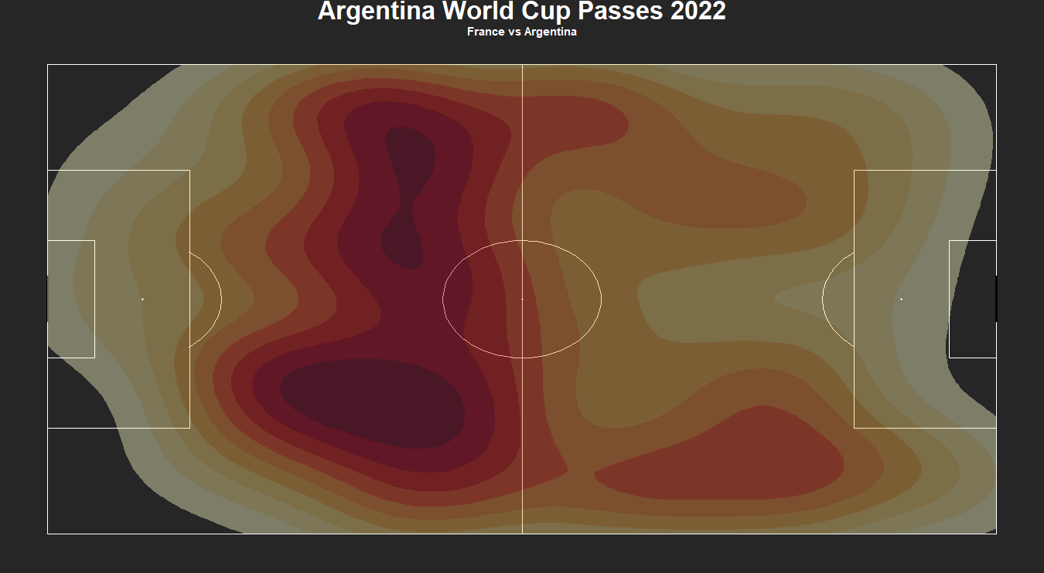
HEAT MAP OF PASS DISTRIBUTION

Slide 9
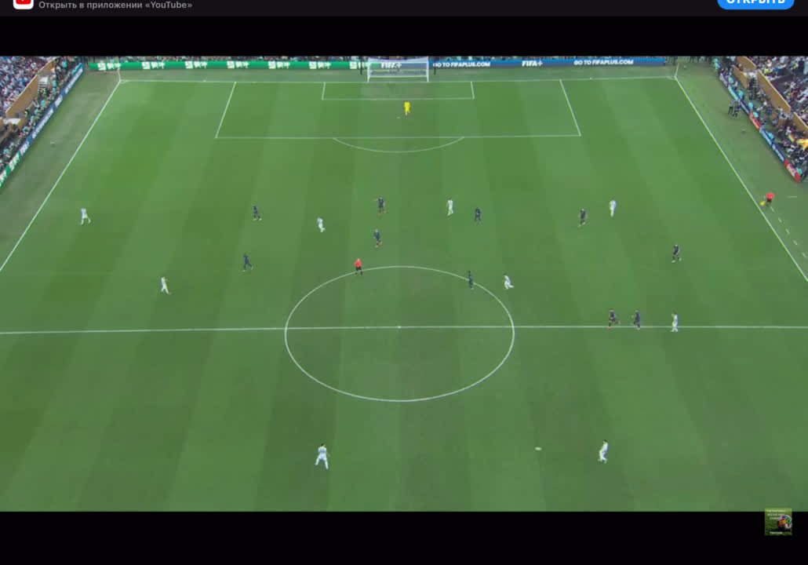

Slide 10
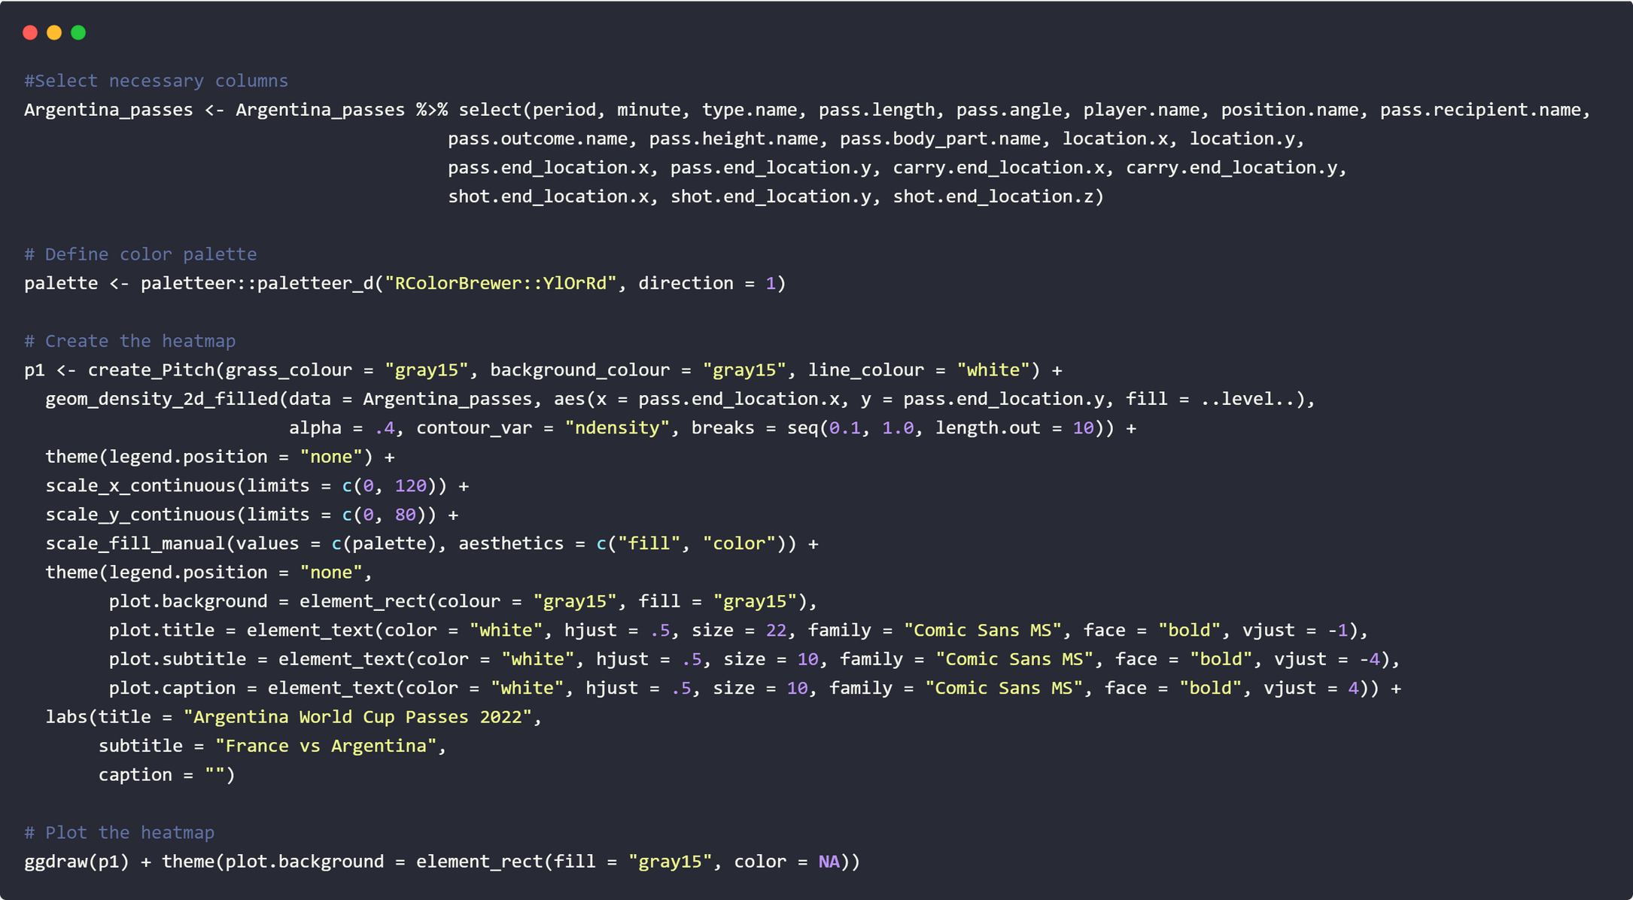
-We use library(SBpitch) and (ggplot2) to plot and draw the heatmap.We visualize the density of pass locations on the pitch for Argentina players

Slide 11
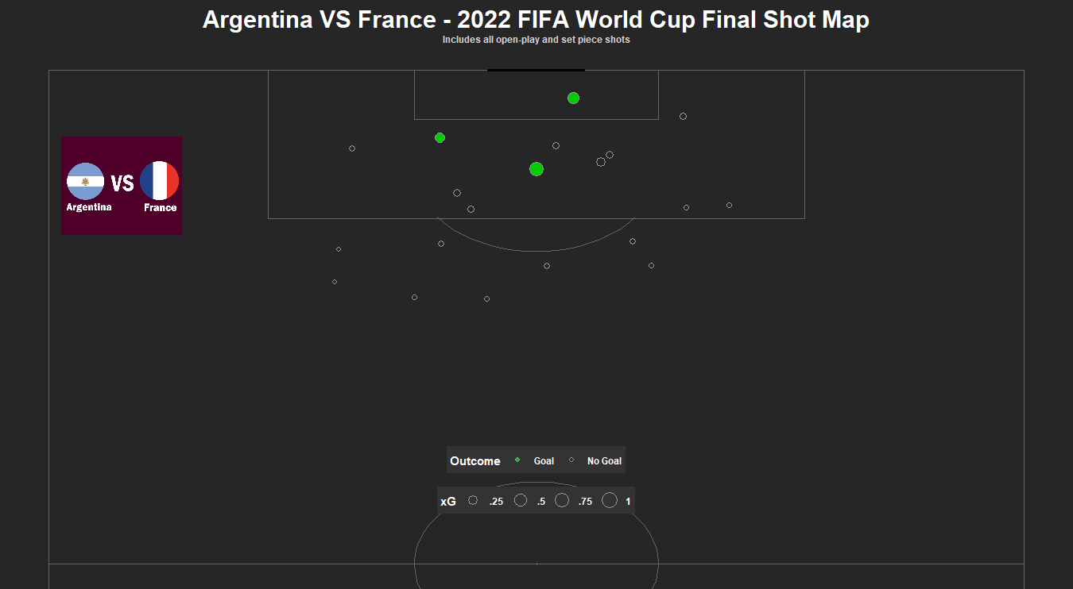
Goal representation map

Slide 12
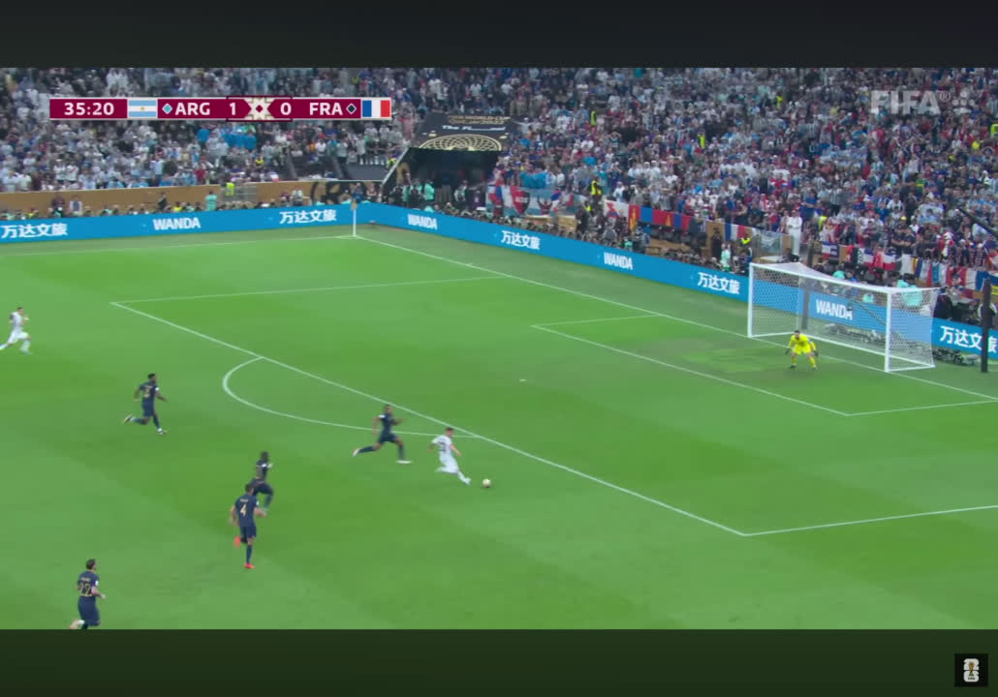

Slide 13
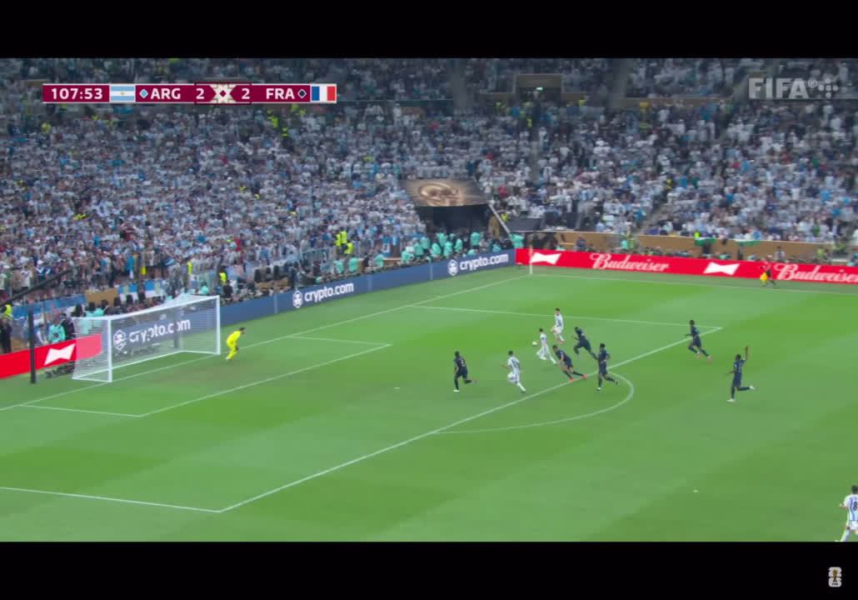
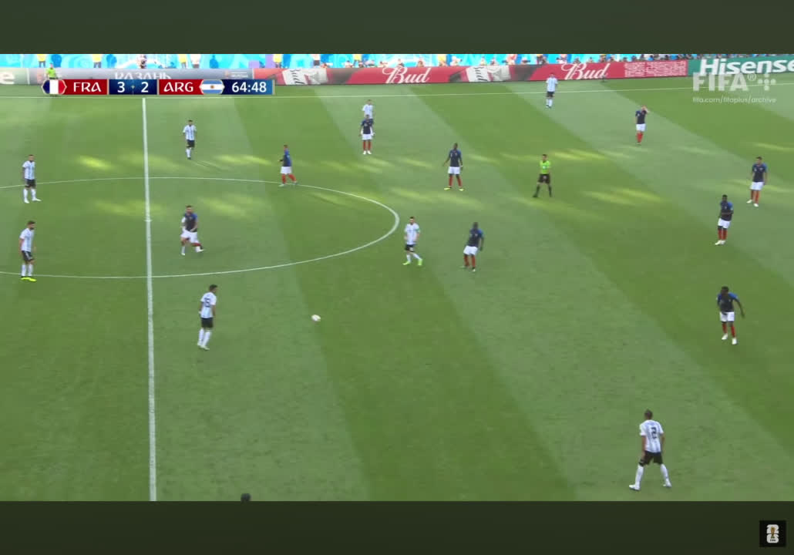

Slide 14

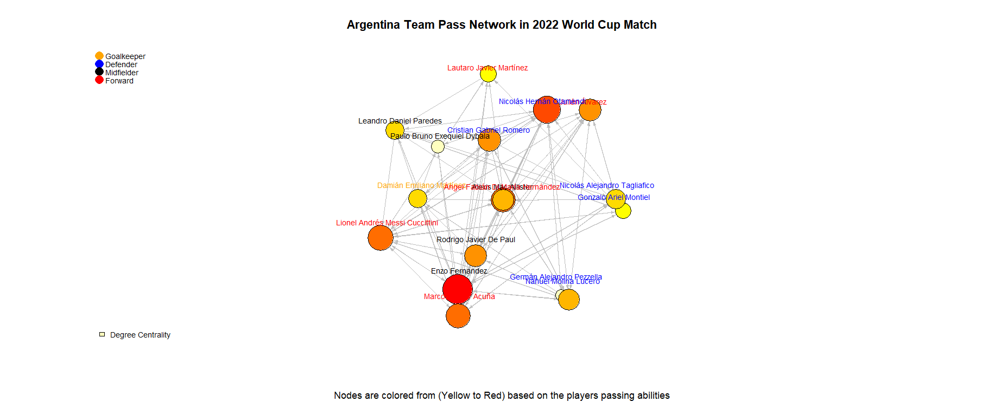
PASS DISTRIBUTION NEURAL NETWORK

Slide 15
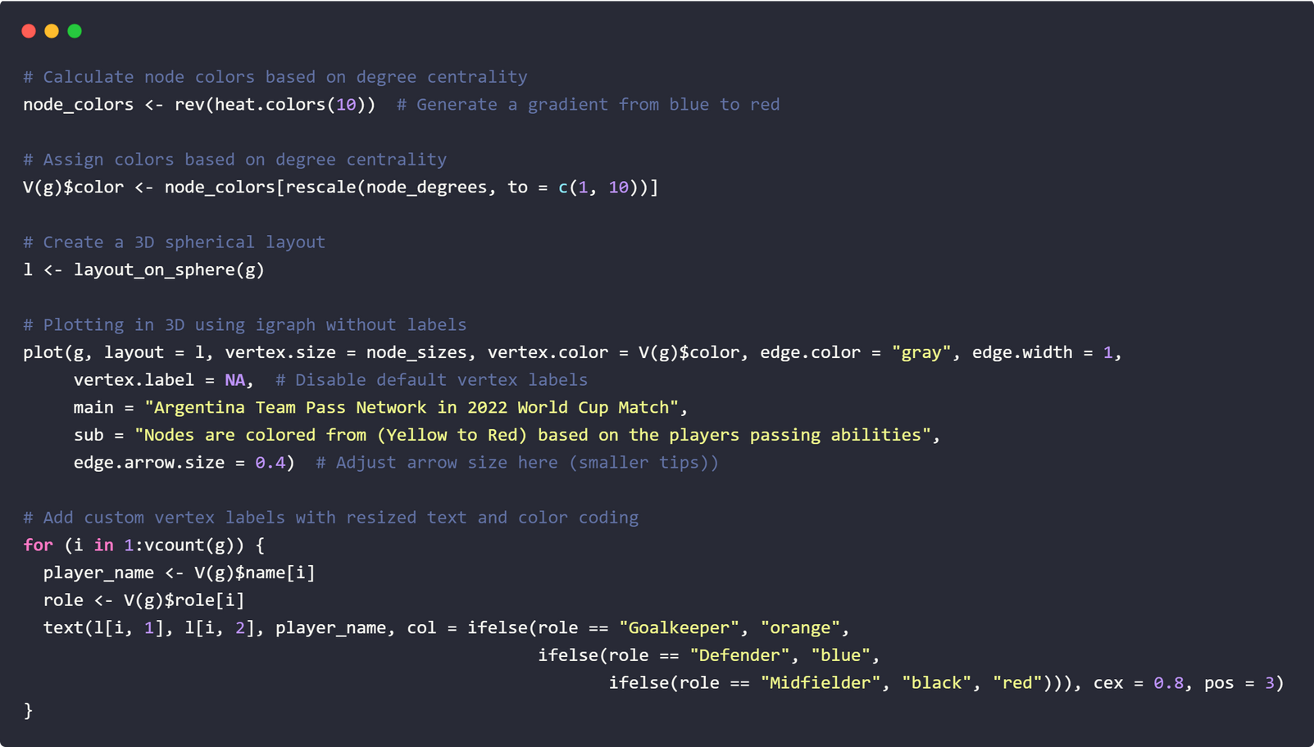
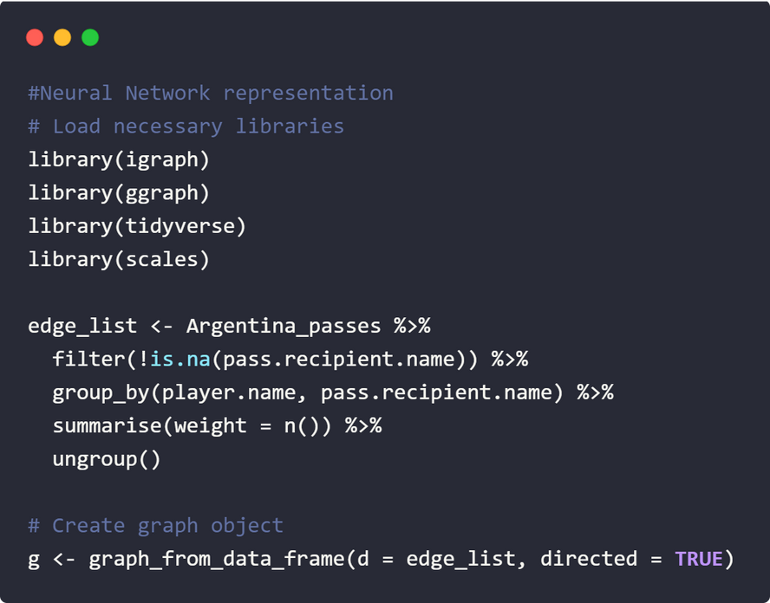
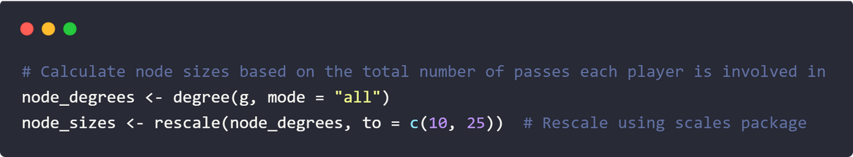
we use igraph: For creating and plotting graph objects.
ggraph: For enhanced graph plotting.
tidyverse: For data manipulation and cleaning.
scales: For rescaling numeric values.
We create an Edge List and filter out passes with no recipient
We Group the data by player and their pass recipient
We count the number of passes between each player pair to use as edge weights
We Define position groups for different roles (Goalkeeper, Defender,
Midfielder, Forward).
Add custom vertex labels for each position and color code them
Map each player to their respective role based on their position
We computes the degree (number of connections) of each node
Rescales these values to determine node sizes for the plot

Slide 16
For the future:
We plan to exponentially update and further improve our neural network with model predictions and better visualisation.We can develop a Linear Regression model for predicting the outcome of future matches,based on certain players impact on previous games.

Slide 17


Thank you for your attention!
References:
1)Heatmap:https://www.youtube.com/watch?v=rBBVSmFJqyE&ab_channel=McKayJohns
2)Data:https://github.com/statsbomb/open-data

Slide 18

GitHub:

